Slide 1
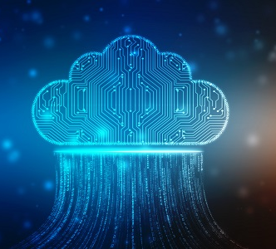

The Cloud An Introduction
Edan Schwartz
Cloud Platform Engineer @ Optum

Slide 2


A quick intro to:
What is the cloud?
How do you cloud?
Why should you care?

Slide 3
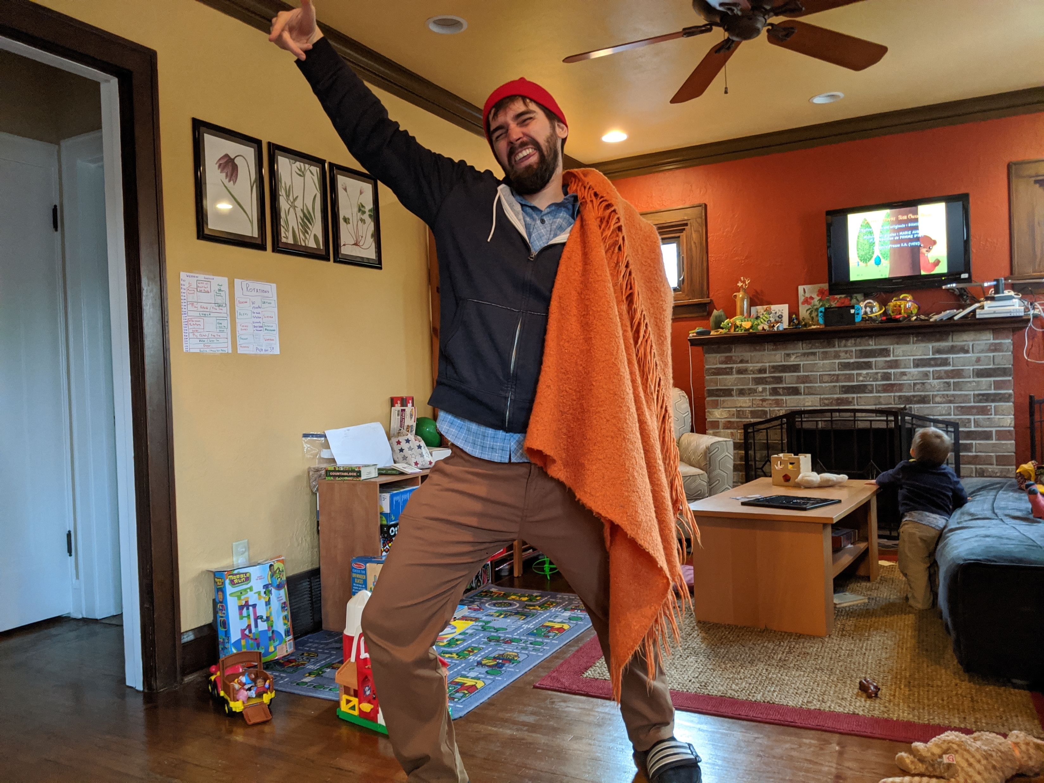
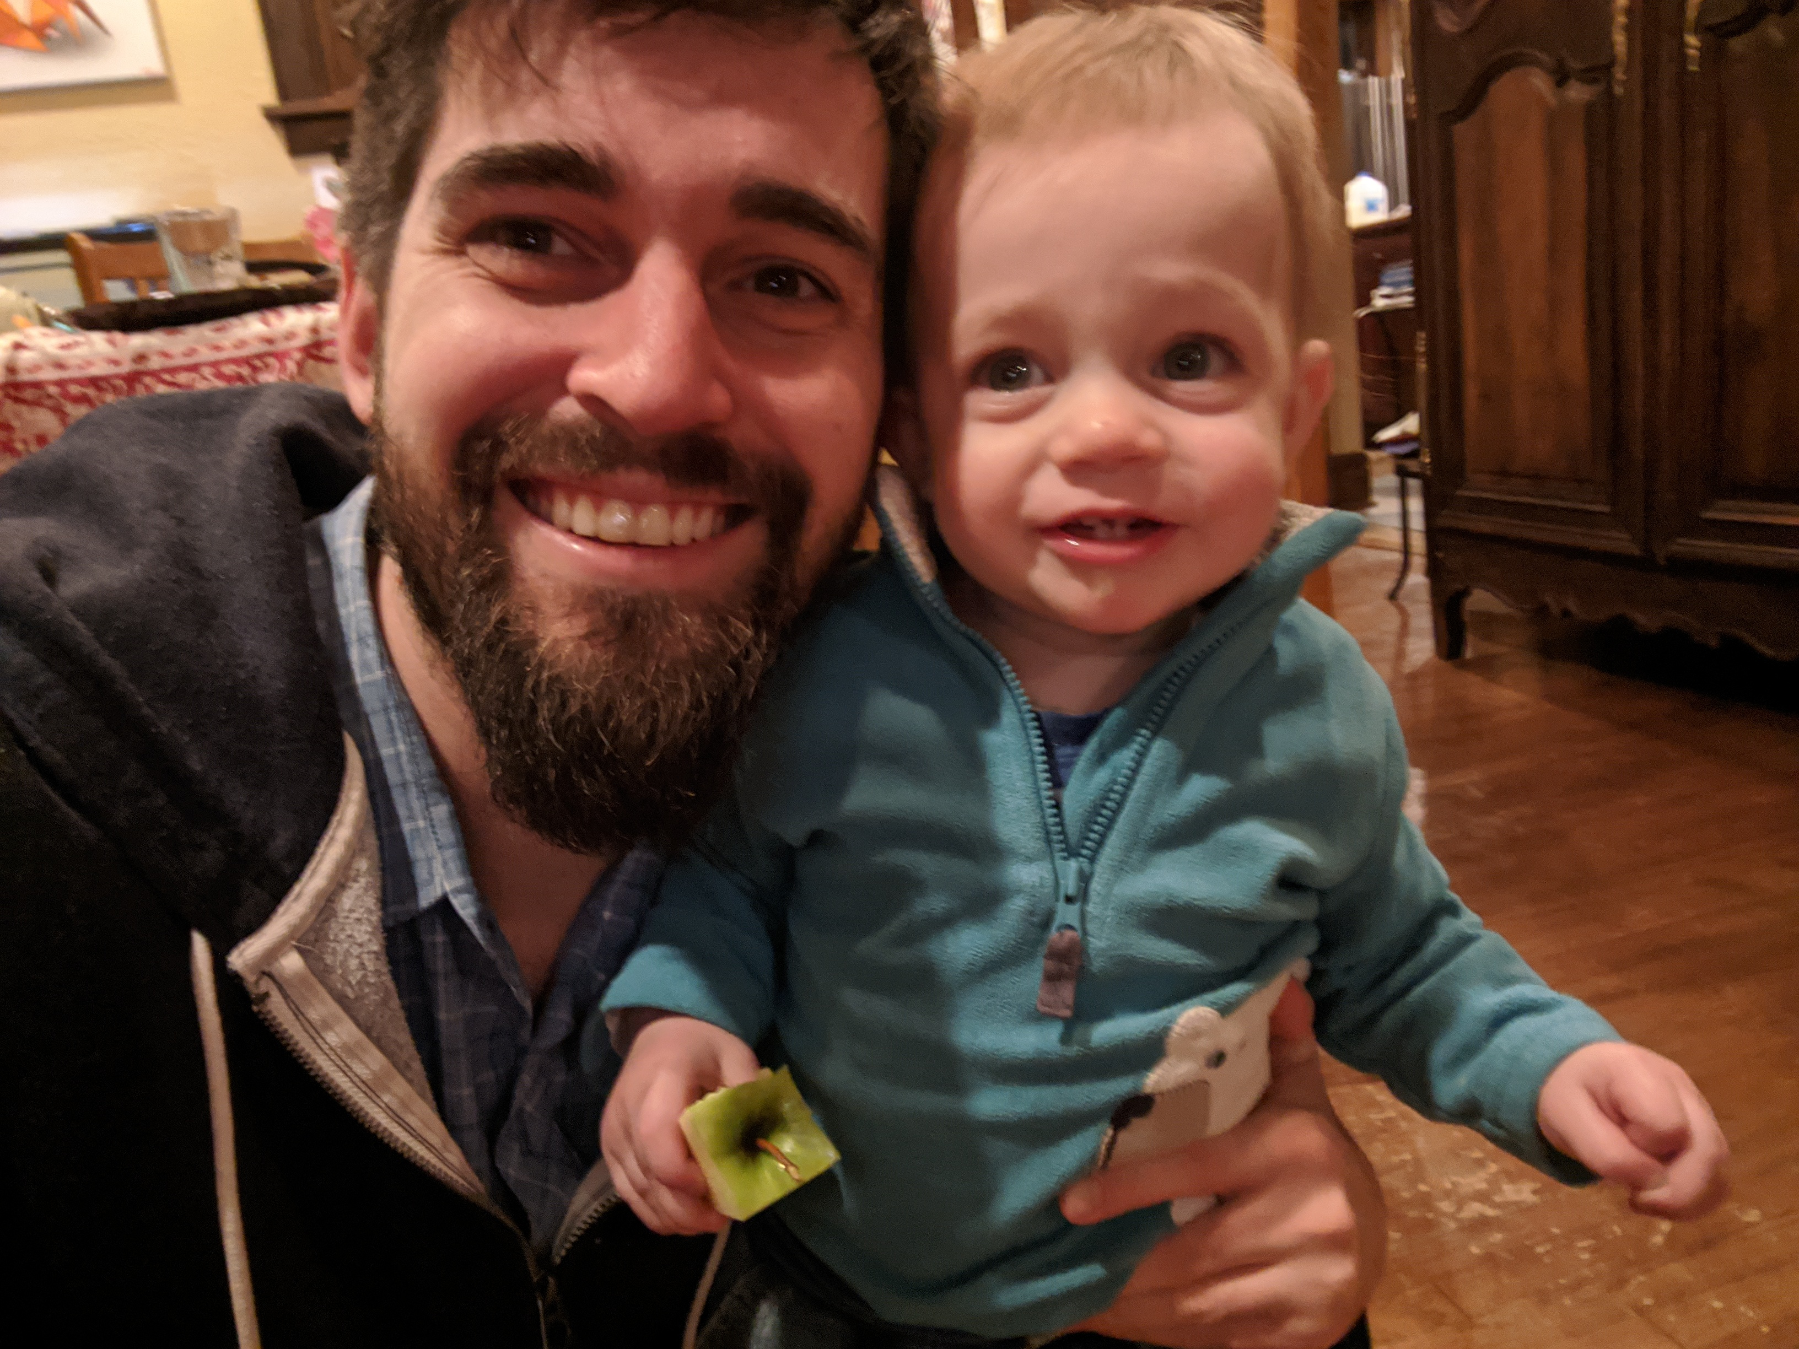
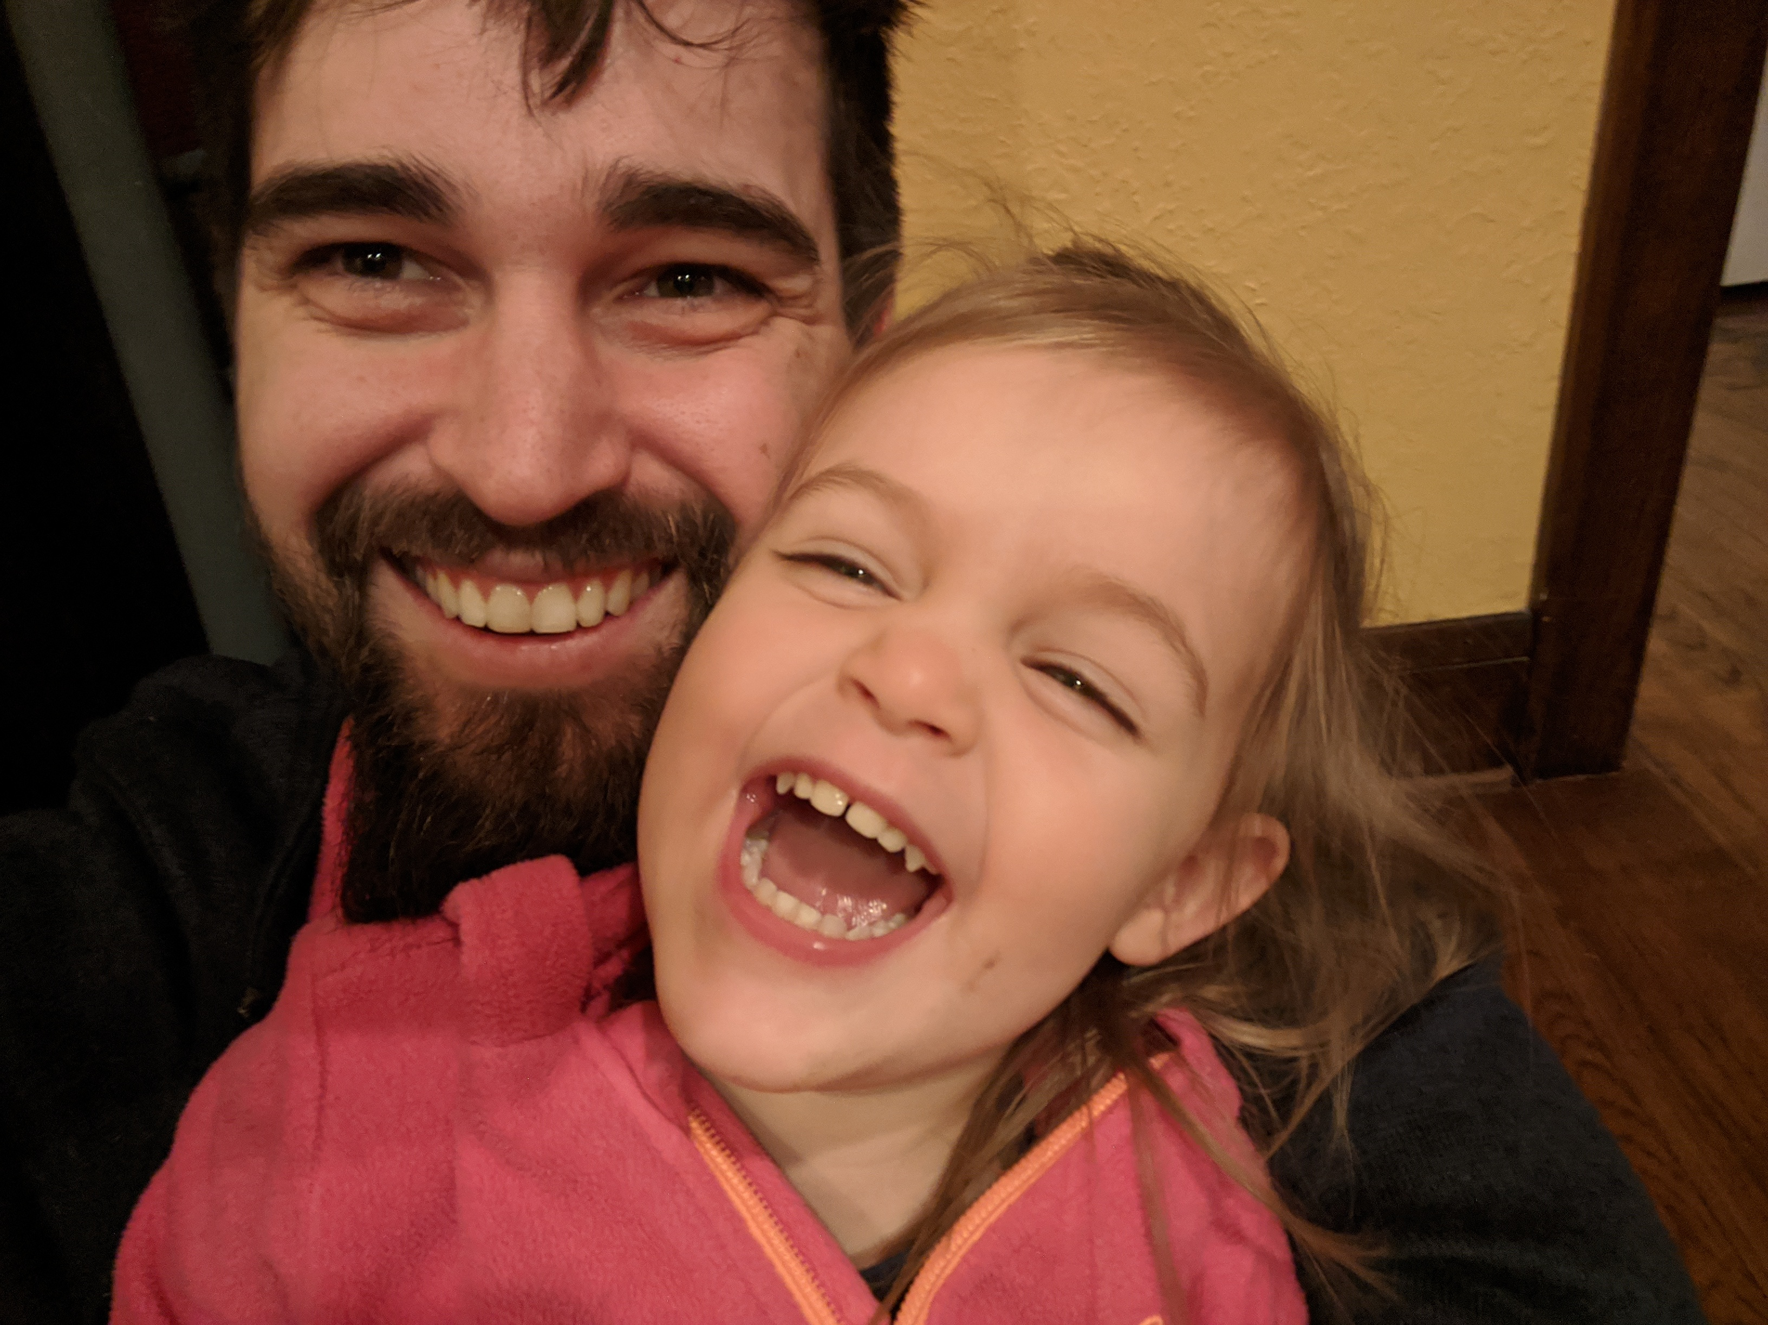
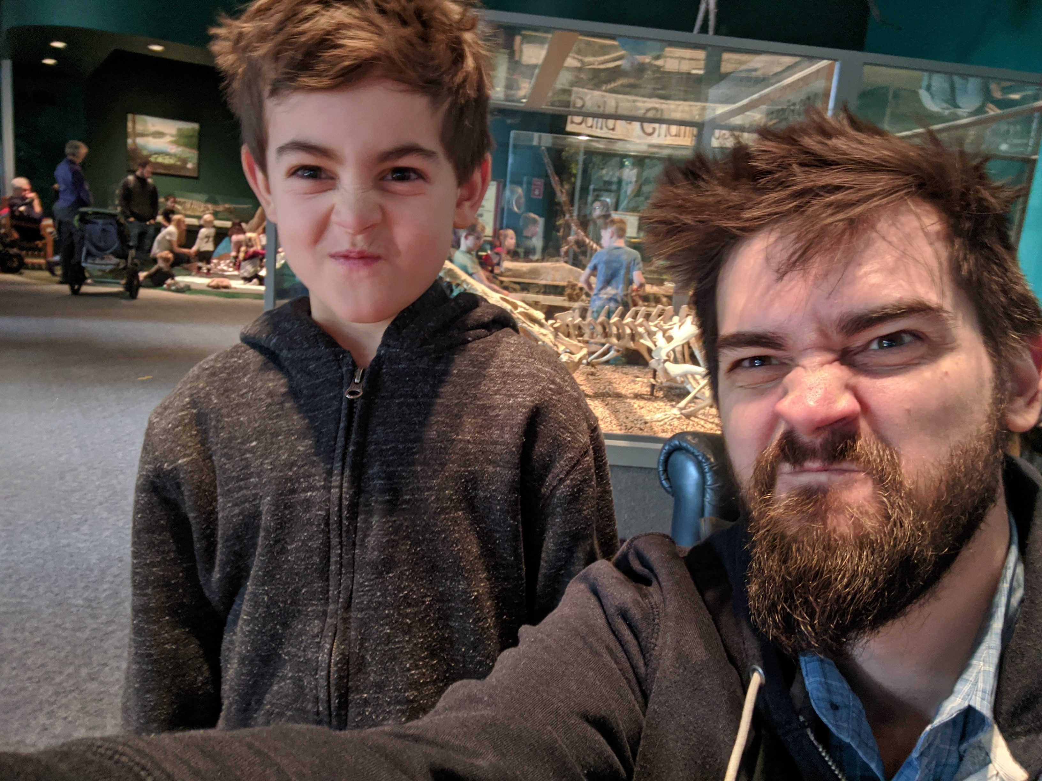
But first…
A bit about me
Notes:
Obligatory kid pics
... and me rocking full-out quarantine style
#. Intro, who am I - what I'm doing now (cloud platform @ Optum, what does that mean, what kind of work does Optum do) - How did I get my start (self taught, maybe Mindbox coffee shop story)

Slide 4

What is the cloud?
Notes:
- Most basic level: someone else's computer ++scale - Anything you can do on your own computer, you can do in a computer in the cloud - Amazon (and Microsoft, Google, et al,) run big farms of computers, stacked up warehouses and let's you rent them out by the hour.
- quick scalling -- can run 1,000 computers - More advanced level: managed services (eg. someone else runs a database, you just get to use it) - The easiest way to deploy your code (if you don't own your own data center)

Slide 5

Demo Time!!!
Notes:
(but first…)

Slide 6
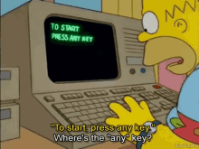
But first…
“Server”
“VM”
A few definitions
or “EC2”
or “instance”
“SSH”
Notes:
#. First, some definitions: - "Server" a computer without a monitor - "VM" / "EC2" / "Instance" basically a server, but that you can create/destroy without actually moving hardware around ("virtualized") - "SSH" a way to "hop into" a server. Lets you send commands, just in Terminal, but over the internet to another machine.
Please ask questions, if you don't know!

Slide 7

Demo Time!!!
Notes:
https://github.com/eschwartz/prime-cloud-intro
# Demo structure: - Intro to web app - Review code - Run app locally - again, not in detail. Just note this: - It's a node / express.js API, some basic HTML/CSS/JS code nothing fancy, nothing special to work in the cloud - Show that it's in a github repo - Login to AWS account (console.aws.amazon.com) - Create EC2 instance - don't need to cover every details just maybe that: - I get to decide what kind of computer I want - I pay per hour (except free tier) - "ports" open for SSH/HTTP (don't worry if that doesn't mean anything to you) - SSH key pair (like a password in a file, to protect my server) While instance is starting up... (quick Q/A?) - Back to EC2: - show that we have a public DNS (web address) for this server - Use that address to SSH - Then, run application

Slide 8

Why should you care?
Notes:
# Why do we care? Or, why do our potential employers care: #. Maybe first -- what is "not the cloud" - Companies (like "Optum") run massive data centers, basically giant warehouses full of computers and networking equipment. And they employ a ton of people to setup and manage these computers, fix them when they break, setup new ones, security patches, etc. - Deployments to datacenters are generally slow, need to request a computer, fill our forms, send faxes, etc - Hoping to outsource this to companies who specialize, and provide automation, making it faster and cheaper Faster: DCE as an example - created an app where engineers can login, create a cloud account, and deploy a web app to it with a single button click (vs. 9 months of "intake" on-prem) So why do **you** care: - 1. Employers care, and you care about being employed lots of companies are migrating to the cloud, having some cloud experience on your resume is going to be a big bump 2. It's cool it's the fastest way to get your own code up and running, you have easy access to advanced tools like AI/ML, super computers, satellites, quantum computers, etc.

Slide 9

The Cloud An Introduction
Edan Schwartz
Cloud Platform Engineer @ Optum
Notes:
Q&A

